Slide 1

Introduction
Self-Assessable Event Permit Management System
Business Requirements Presentation
Sunshine Coast Council Project
Presented to the general public by: [Your Name]
Function: Junior Business Analyst / Project Coordinator.
Feedback: Do more of this.Feedback: Make better use of low-risk permit applications.
Goal: Streamline customer experience and reduce manual processing
Notes:
Good morning everyone. I'm [Your Name] and I am going to make a presentation to Sunshine Coast Council on the major points of the Business Requirements Document for the Self-Assessable Event Permit Management System. The aim of this project is to enhance the efficiency of the low risk event permit stream by implementing a digital self-service platform. The proposed solution is designed to streamline administration, enhance the customer experience, and help the council achieve its digital transformation goals.

Slide 2

Current Business Problem
Existing Challenges Identified
The current approvals process is quite manual
It takes 10 days to receive non-wedding approvals.
Significant coordination with stakeholders was needed
Students in the classroom are not aware of the changes in their education.
The administrative workload of staff is significant.
Some venues are hard to see as they are actually sold out.
Customer's experience is inconsistent and slow
Notes:
Stakeholder interviews revealed some challenges for the current process. This is a very manual and resource-heavy process, especially for non-wedding events; a process that can take up to 10 days to process with the required consultations with stakeholders. There is a lot of internal coordination time taken and applicants wait for venues and have poor visibility status quo for their applications. The inefficiencies place a burden on council resources and have a negative impact on customer satisfaction

Slide 3

Proposed Solution and Scope
Existing Challenges Identified
An online permit application system that can be self-submitted.
Automated Approval of wedding bookings.
The availability of public space visibility
Place Food Trucks functionality for booking locations.
Ability to integrate with SCC calendar systems.
Staff dashboards for escalated applications.
Notes:
The proposed solution is a self-service permit management platform with ICT. The first phase will be targeted at the least risky categories of permits, such as food truck permits, high volume public spaces, and weddings. Venue availability and self-assessment will be available online and applicants will be able to submit applications online. Manual approvals will be minimised through automated workflows and staff dashboards will help manage escalated or complex applications. The system will also be compatible with current council calendar systems to prevent clashes

Slide 4
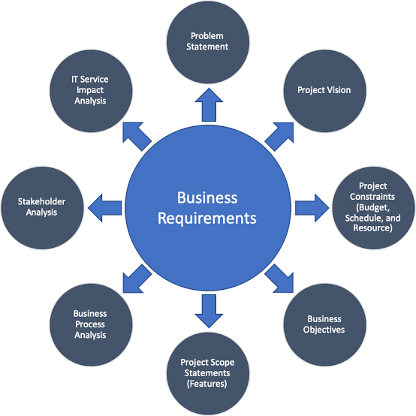
Key Business Requirements
Critical Requirements Identified
Shorten the permit approval time to less than 48 hours.
Automated eligibility validation
Convenient booking and availability checking in real-time.
Automated customer notifications
Easy-to-use interface, requires little training.
Operational reporting & analytics
Notes:
During stakeholder consults, several critical business and functional requirements were identified. Processing times for low-risk permits should be considerably shortened, and eligibility for low-risk permits should be automatically validated. Applicants will be more transparent thanks to real-time venue availability checks and automated notifications. Internal stakeholders also pointed to the need for an easy-to-use interface that needs little training. In addition, management reporting will provide council leaders with tools to track efficiency, staffing and operations.

Slide 5
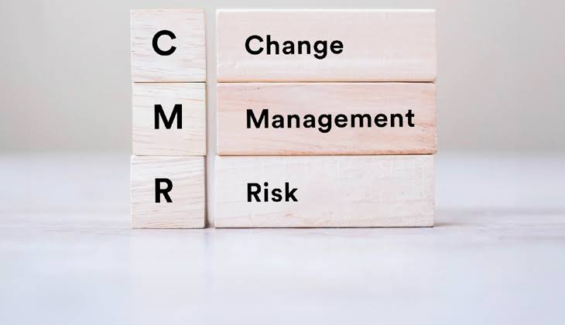
Risks and Change Management
Risk Assessments and Mitigation Strategies
There is opposition to automation within the workplace.
Support for integration with existing systems, along with various other considerations.
There may be potential hidden administrative burdens.
There is need for comprehensive and detailed staff training.
Importance of early stakeholder engagement
Notes:
Organisational change resistance is one of the key project risks found by HR stakeholders. Staff might be uncertain about automation and/or new roles. To do this, there will be a need for early engagement of stakeholders and thorough training programmes. Other hazards include integration difficulties with current SCC systems and the potential for unintended administrative problems if workflows aren't developed properly. User acceptance testing and phased implementation strategies will help minimise these risks.

Slide 6
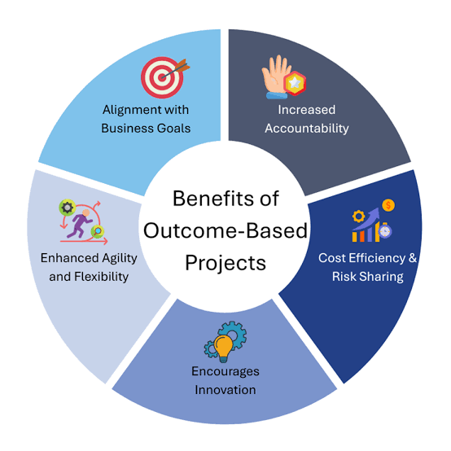
Expected Business Benefits
Project Outcomes
Faster permit approvals
Improved customer experience
Reduced administrative workload
Better workforce allocation
Increased operational transparency
Gaining greater digital transformation capability
Notes:
The proposed solution will provide a number of significant business benefits to Sunshine Coast Council. These include very rapid permit approvals, better experience for community groups and applicants and less manual workload for internal staff. The system will also increase the transparency of operations and give increased reporting options for decisions management. Most importantly, it aligns to the council's overall digital transformation initiative and provides a scalable base for the future expansion of services.

Slide 7
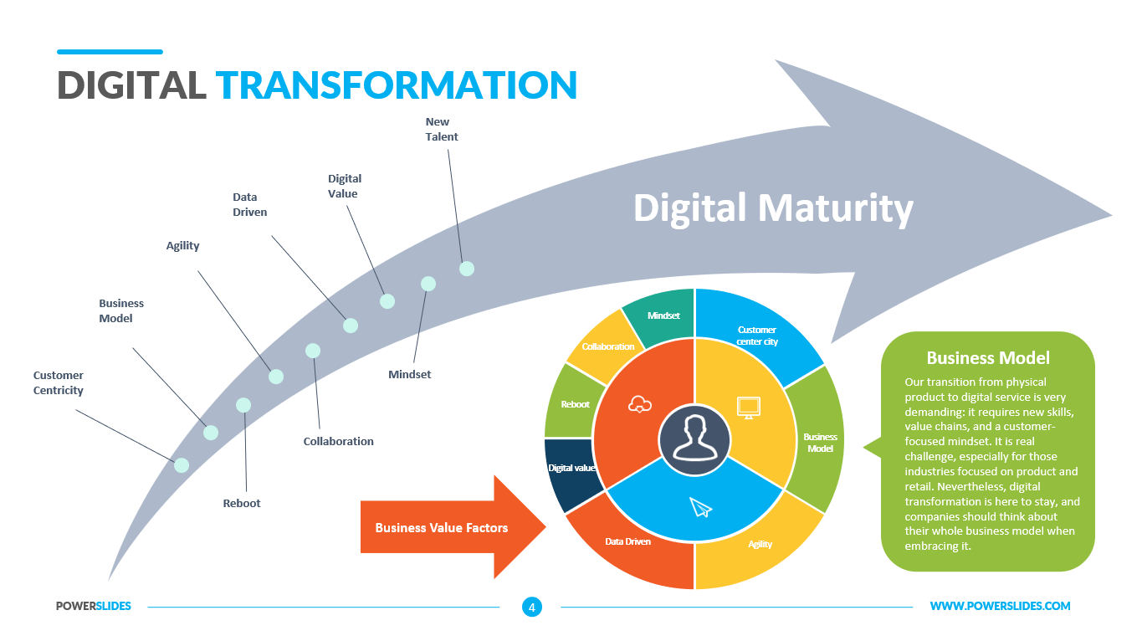
Conclusion
Final Recommendation
Move more slowly with phased implementation
Schedule weddings and events with little risk first
Pay attention to staff training and adoption!
Continue to involve stakeholders during rollout
Measure performance using reporting dashboards.
Notes:
Overall, the Self-Assessable Event Permit Management System offers a viable and scalable solution to enhance event permit management at Sunshine Coast Council. It is suggested that a phased approach is taken to implementation, starting with those events that are the least risky, such as weddings. Continuous stakeholder involvement, staff capacity building and tracking of performance will be essential to achieving successful uptake and long running project success. Thank you for your time, I'm happy to answer any questions.

